Slide 1

Lecture 5
-NLP is all about words, their arrangement and their meaning
-NLP is a branch of AI that tries to emulate/understand the way a human speaks to another human
-Lecture 5 is about text searching/string matching using regular expressions
(Ch. 2 of Jurafsky Martin)

Slide 2
Regular expression (R.E.)
Introduced by Kleene (1956)
It is a formal notation for a sequence of symbols that denote the text snippet we are interested in.
Text matching implemented through Finite State Automata-FSA (or DFA)

Slide 3
How to specify a regular expression?
Identify the input text or string to be matched.
Design the R.E. for this text and place it within slashes /R.E./
Usually, the first match in the document is returned (alternatively, every match can be returned!)
Now we will see some examples:
Ex 1- Text: Natural Language Processing
R.E.:
/Natural˽Language ˽Processing/

Slide 4
How to specify a regular expression?...........
Consider the para (test document)
I love Natural language processing because NLP is my favorite subject. Natural Lang Processing is also a subject in seventh semester. Processing Natural Language is the aim of the subject Natural Language Processing.
Text search:
Natural Language Processing : RE: /Natural˽Language ˽Processing/
(Searching using RE means searching for a perfect match)- Only 1 perfect Match (in red)
I love Natural language processing because NLP is my favorite subject. Natural Lang Processing is also a subject in seventh semester. Processing Natural Language is the aim of the subject Natural Language Processing.

Slide 5
How to specify a regular expression?...........
Other examples of R.E. for Natural Language Processing
(Suppose we also want other strings to be matched as well since after all they were all referring to the subject of NLP)
1. Include Natural language processing
RE: /[Nn]atural˽[Ll]anguage ˽[Pp]rocessing/
2. Include Natural Lang Processing
RE: /Natural˽Lang(uage)? ˽Processing/
3. Include NLP
RE: /(Natural˽Language ˽Processing)|NLP/

Slide 6
How to specify a regular expression?...........
Some more examples of R.E.s (with too much flexibility allowed!)
1. For people who pronounce Language as Languaaa…age (which is the word that will appear in the transcript)
RE: /Natural˽Langua*ge ˽Processing/ (0 or more a’s) OR
RE: /Natural˽Langua+ge ˽Processing/ (1 or more a’s)
2. For people who pronounce Language as L….ge (portion in the middle is not audible and varies from person to person- like in poor quality audio)
RE: /Natural˽L .*ge ˽Processing/

Slide 7
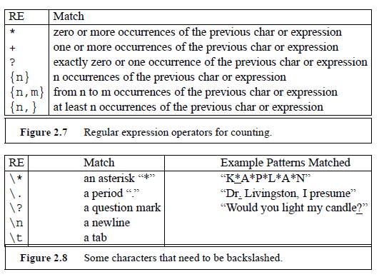
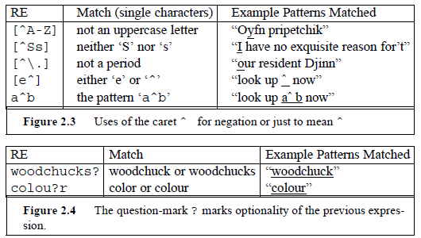
How to specify a regular expression?...........
Some other examples of R.E.s:

Slide 8
Now please answer the MCQ in Moodle (by Monday 31st Aug 2020, 11 pm)

